Slide 1

INTRODUCTION TO ARTIFICIAL INTELLIGENCE
Presented by Group 6
March 2nd, 2019

Slide 2
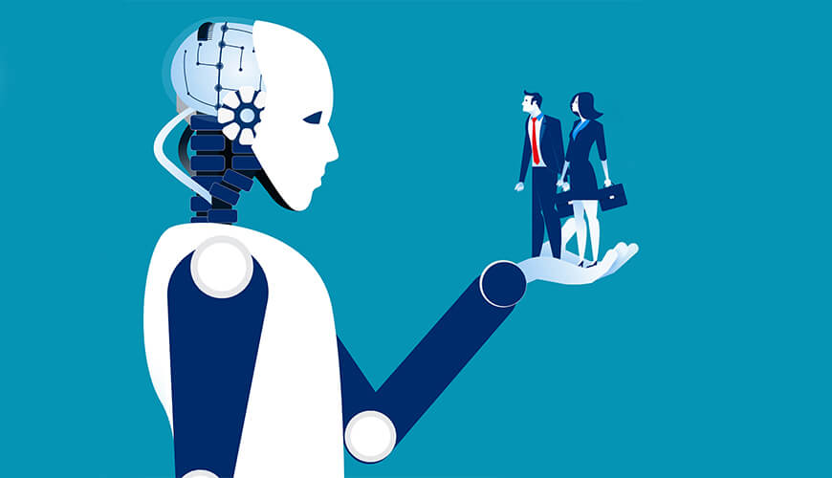
Members
Le Tuan – ITITIU16142 Tran Duc Khoa – ITITIU16101 Do Ngoc Thanh Tuyen – ITITIU16062 Nguyen Phan Hung Thuan – ITITIU16130

Slide 3
ARTIFICAL INTELLIGENCE: HISTORY AND APPLICATIONS
CHAPTER 1:

Slide 4

This is a picture of two special people, can you realize who them are?

Slide 5
Outline
WHAT IS ARTIFICIAL INTELLIGENCE?
ARTIFICAL INTELLIGENCE HISTORY
The gestation of AI
The birth of AI
1952 – 1969
1980 – present
ARTIFICAL INTELLIGENCE APPLICATIONS
SUMMARY

Slide 6
1. What is AI?

Slide 7
1. What is AI?
For thousands of years, human have tried to understand how we think. The technology develops strongly make us want it to think and do like what human can do.
AI work started after WWII, and was named in 1956
AI encompasses variety of subfields, some particular fields: playing game, writing poertry, self-driving car, …

Slide 8
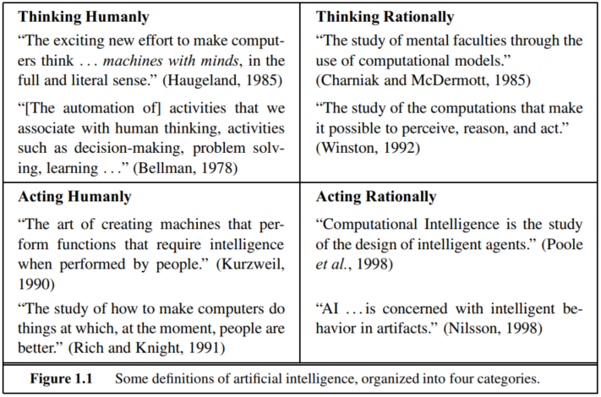
1. What is AI?
Page 2 Russel2016 (There are many definitions but all of them wrap around 2 words (“humanly” and “rationally”))

Slide 9
1. What is AI?
Acting humanly: The Turing Test approach

Slide 10
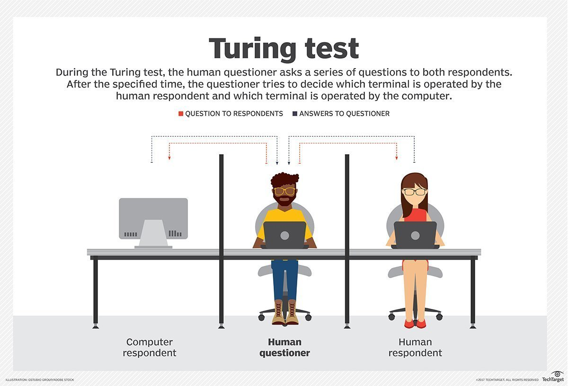
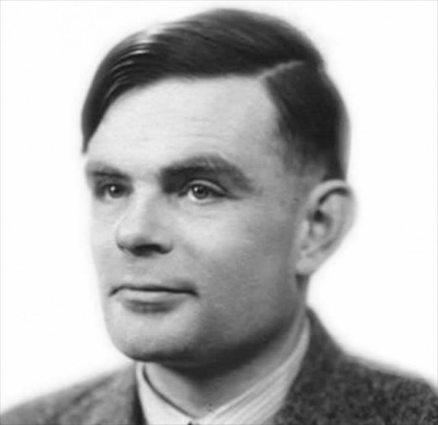
Alan Turing (1912-1954)

Slide 11
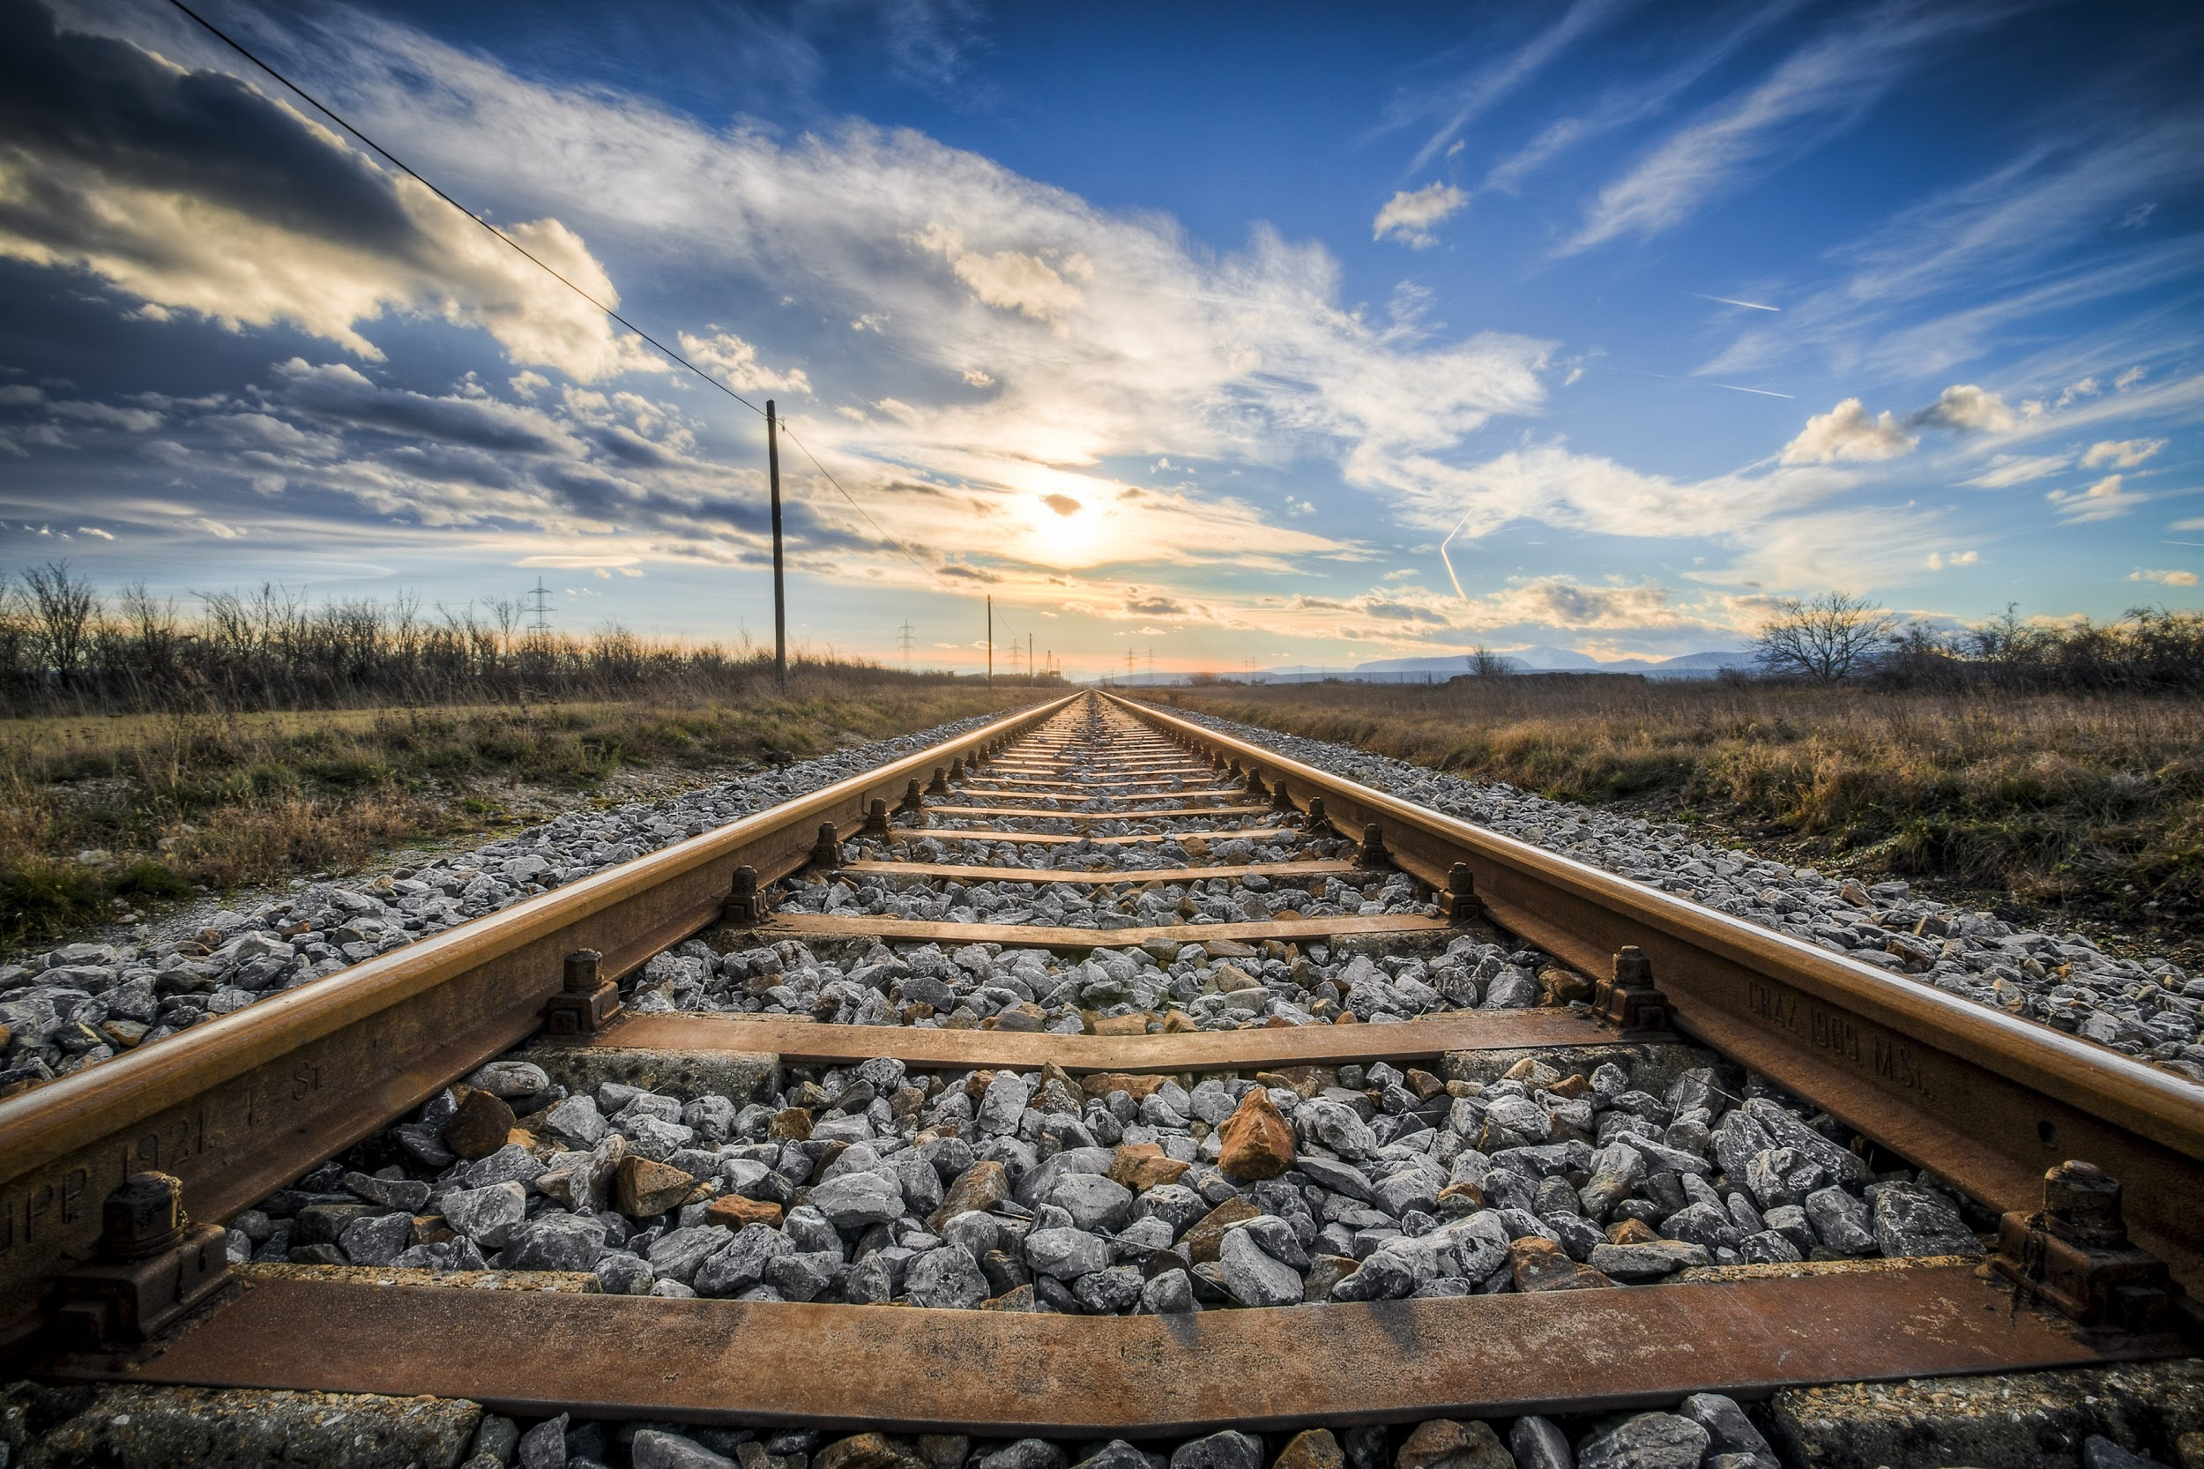
2. Artificial Intelligence history
Notes:
https://pixabay.com/en/gleise-old-railroad-tracks-seemed-1555348/

Slide 12
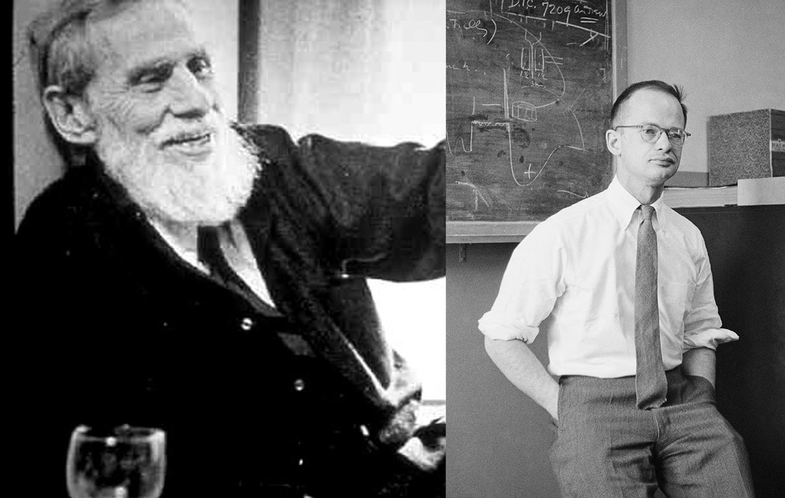
The gestation of AI (1943-1955)

Slide 13
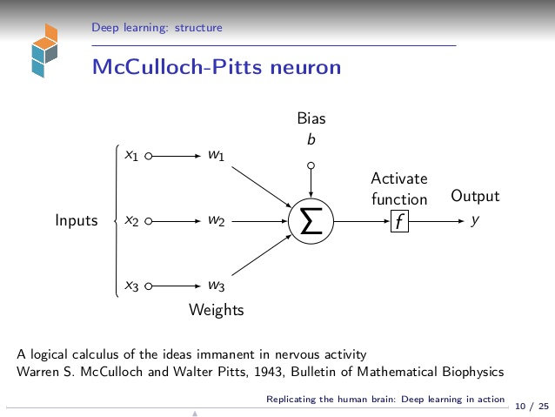
The gestation of AI (1943-1955)
McCulloch-Pitts neuron model (1943):

Slide 14
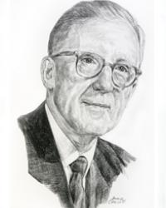
The gestation of AI (1943-1955)
1949: Donald Hebb published “Organization of Behavior: A neuropsychological” The Hebbian Learning Rule is a learning rule that specifies how much the weight of the connection between two units should be increased or decreased in proportion to the product of their activation. (Deep learning cars: Click here to watch!)
1950: Alan Turing publics article “Computing Machinery and Intelligence”, concluding Turing Test, machine learning, genetic algorithms and reinforcement learning

Slide 15
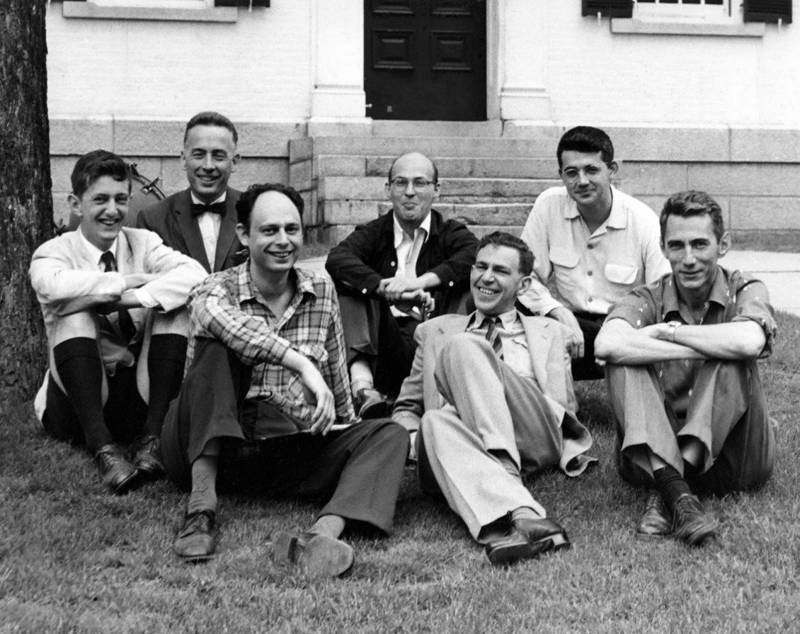
The birth of AI (1956)
Dartmouth Project Team

Slide 16
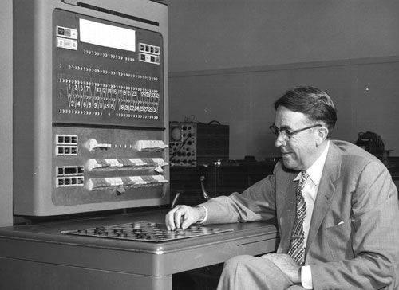
Early enthusiasm, great expectations (1952 – 1969)
1952: Arthur Samuel develops the first computer checkers-playing program
Arthur Samuel plays checkers with an IBM 704 computer in Poughkeepsie, New York

Slide 17
Early enthusiasm, great expectations (1952 – 1969)
1958
1961
1961
1968
James Slagle developed SAINT (Symbolic Automatic Integrator), a heuristic program solving symbolic integration problems in calculus.
John McCarthy develops programming language Lisp which becomes the most popular programming language used in artificial intelligence research.
The first industrial robot named “Unimate” starts working in General Motors, New Jersey
Terry Winograd developed SHRDLU, an early natural language understanding computer program
Notes:
<a href="http://www.freepik.com/free-photo/top-view-of-co-workers-planning-a-strategy_864127.htm">Designed by Freepik</a>
http://www.freepik.com/free-photo/happy-co-workers-close-to-the-window_866124.htm

Slide 18
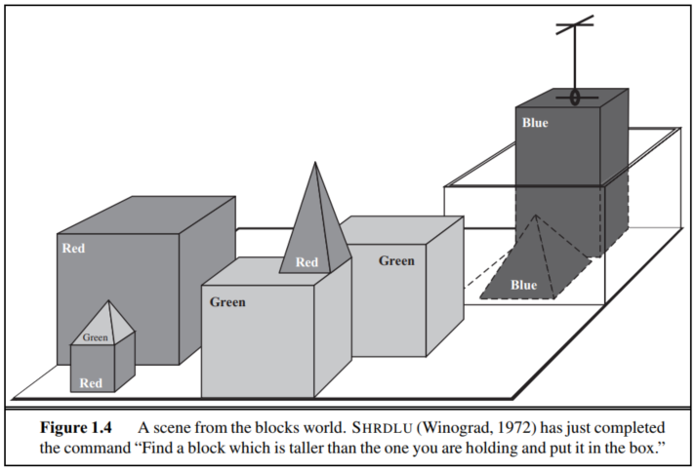
Early enthusiasm, great expectations (1952 – 1969)

Slide 19
1980 – Present
1981: The Japanese Ministry of International Trade and Industry budgets $850 million for Fifth Generation Computer project, it was aimed to develop computers can take conversations, translate languages, interpret pictures, and reason like human.

Slide 20
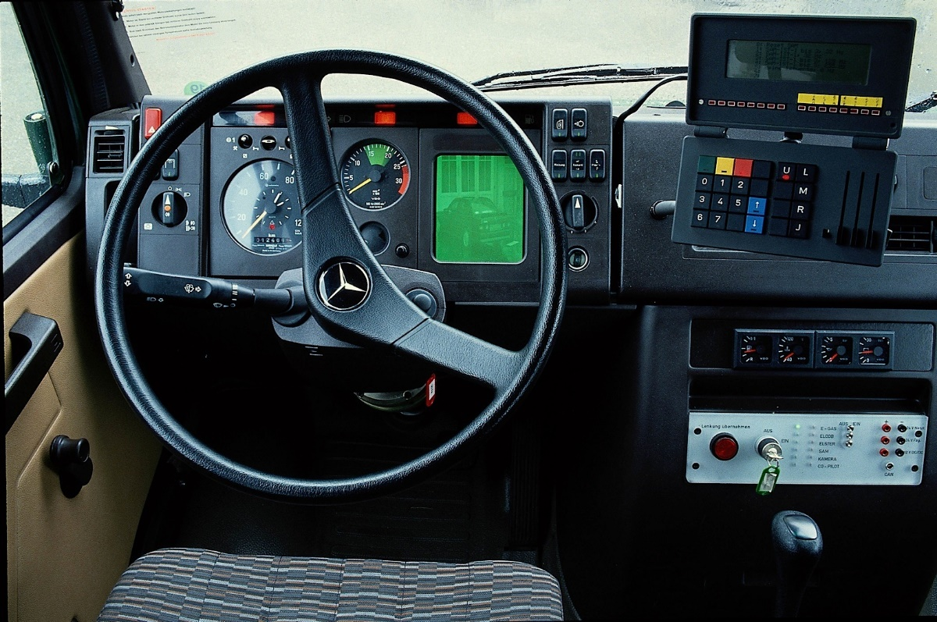
1980 – Present
1986:
First driverless car, a Mercedes-Benz van equipped with cameras and sensors was built at Bundeswehr University in Munich, drives up to 88.5km/h on empty streets.

Slide 21
1980 – Present
1986: Devid Rumelhart, Geoffery Hinton and Ronald Williams public “Learning representations by backpropagating errors”, mark for the return of neural networks
1988: Rollo Carpenter develops the chat-bot Jabberwacky to “simulate natual human chat in an interesting, entertaining and humorous manner”.
1989: Yann LeCun and other researchers at AT&T Bell Labs successfully apply a backpropagation algorithm in multi-layer NN.
1997: Sepp Hochreiter and Jurgen Schmidhuber propose Long Short-Term Memory (LTSM), a type of recurrent neural network used in handwritting recognition and speech recognition today.

Slide 22
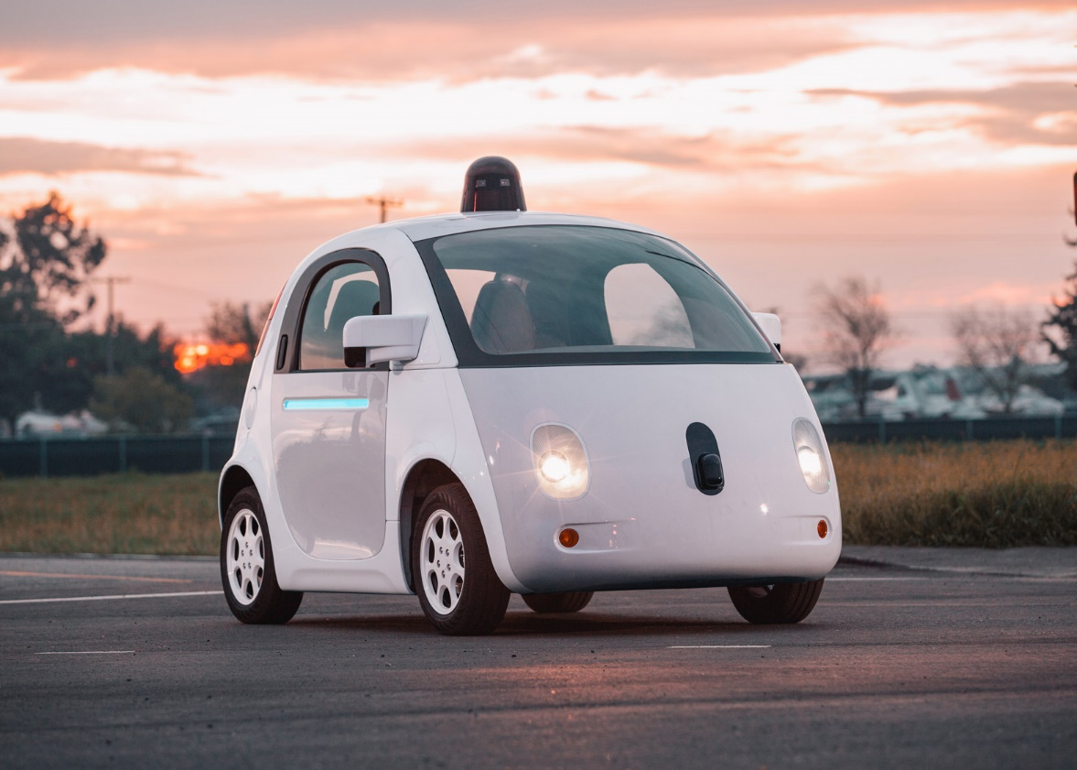
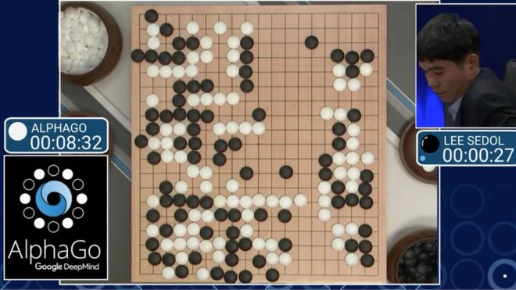
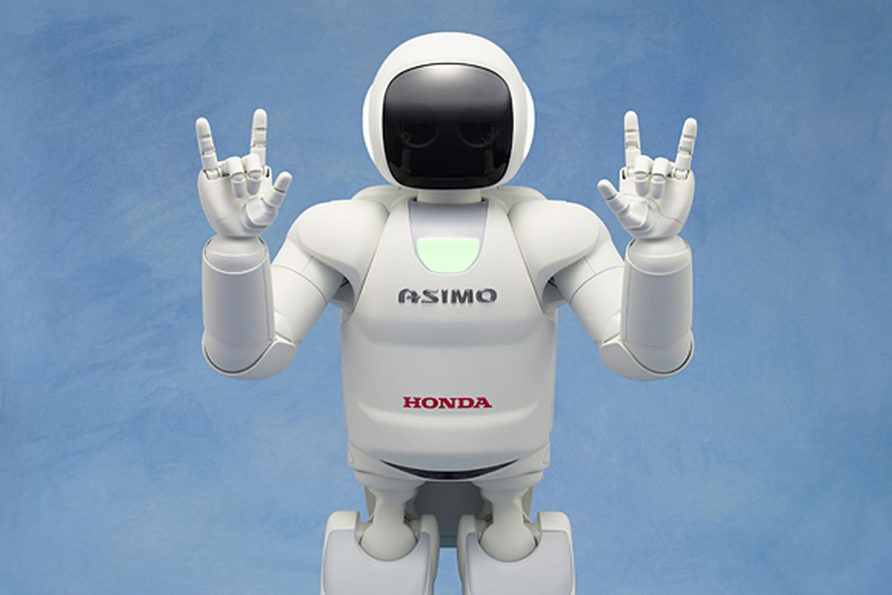
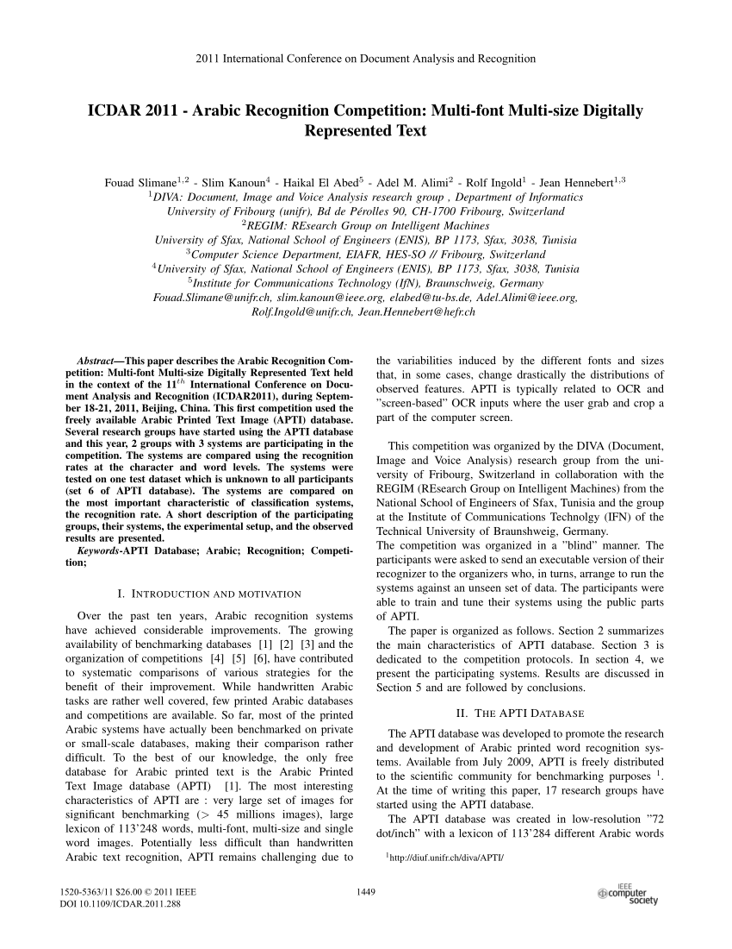
1980 – Present
2000: Honda ASIMO robot
2011: Researchers in Switzerland report a 0.27% error rate in handwriting recognition
2009: Google starts secret project, a driverless-car, and it first pass test in 2014
March 2016: Google DeepMind; s AlphaGo defeats Lee Sedol.

Slide 23
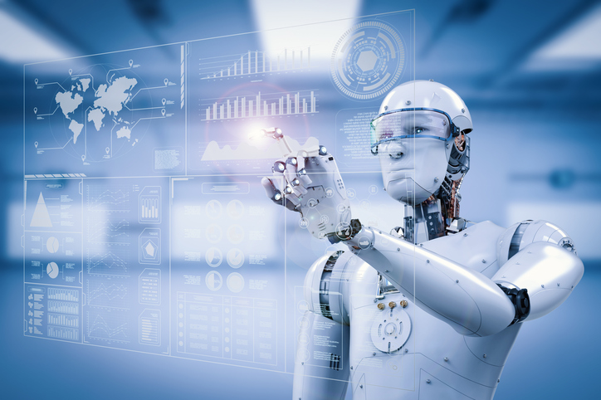
3. Few applications of Artificial Intelligence
Notes:
<a href='http://www.freepik.com/free-photo/smiling-businesspeople-having-a-business-meeting_862394.htm'>Designed by Freepik</a>

Slide 24
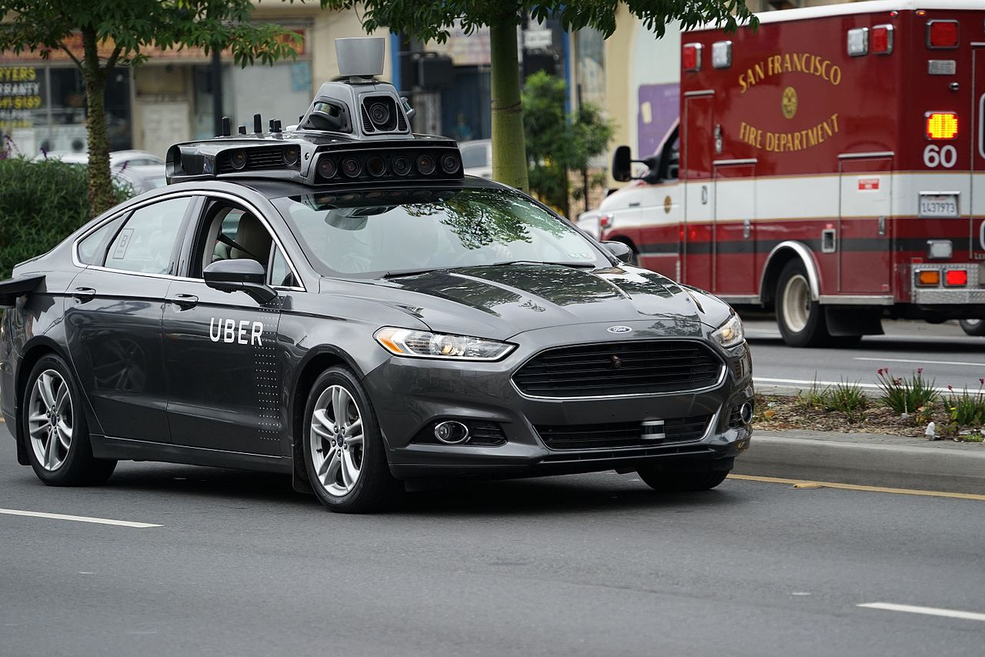
Robotic vehicles
Artificial Intelligence (AI) gives cars the ability to see, think, learn and navigate a nearly infinite range of driving scenarios. The power of AI and deep learning to deliver a breakthrough end-to-end solution for autonomous driving—from data collection, model training, and testing in simulation to the deployment of smart, safe, self-driving cars.
With the help of AI
Uber autonomous vehicle prototype testing in San Francisco.

Slide 25

Speech recognition
Google Speech-to-text conversion powered by machine learning apply the most advanced deep-learning neural network algorithms to audio for speech recognition with unparalleled accuracy and also available for short-form or long-form audio.

Slide 26
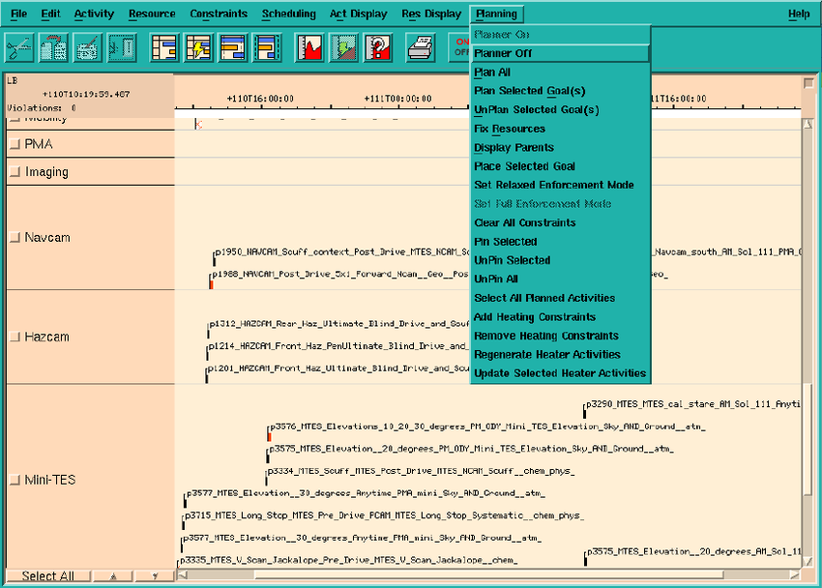
Autonomous planning and scheduling:
Automated planning and scheduling, sometimes denoted as simply AI planning that concerns the realization of strategies or action sequences, typically for execution by intelligent agents, autonomous robots and unmanned vehicles.

Slide 27

Autonomous planning and scheduling:
This artificial intelligence software is called the Mixed-initiative Activity Plan Generator (MAPGEN) plan the daily operation for NASA's Mars Exploration Rovers

Slide 28
Game playing
For humans, chess may take a lifetime to master. But Google DeepMind’s artificial intelligence program, AlphaGo, can teach itself to conquer the board in a matter of hours.
32%
70%
Notes:
<a href='http://www.freepik.com/free-photo/skyscraper-urban-view_881301.htm'>Designed by Freepik</a>

Slide 29
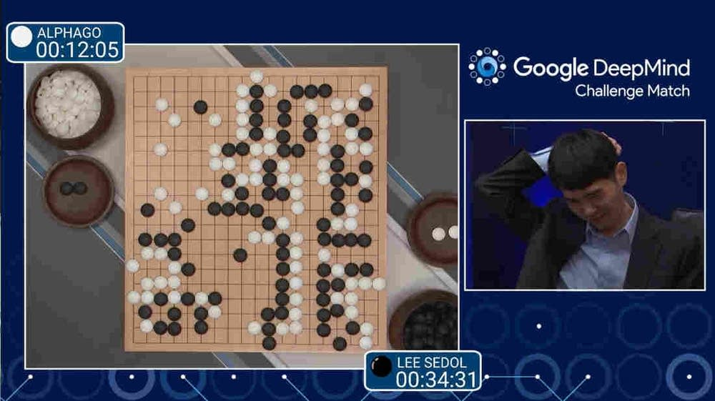
Game playing
32%
70%
Go champion Lee Sedol played a close game against AlphaGo, but resigned to end their first contest
Notes:
<a href='http://www.freepik.com/free-photo/skyscraper-urban-view_881301.htm'>Designed by Freepik</a>

Slide 30
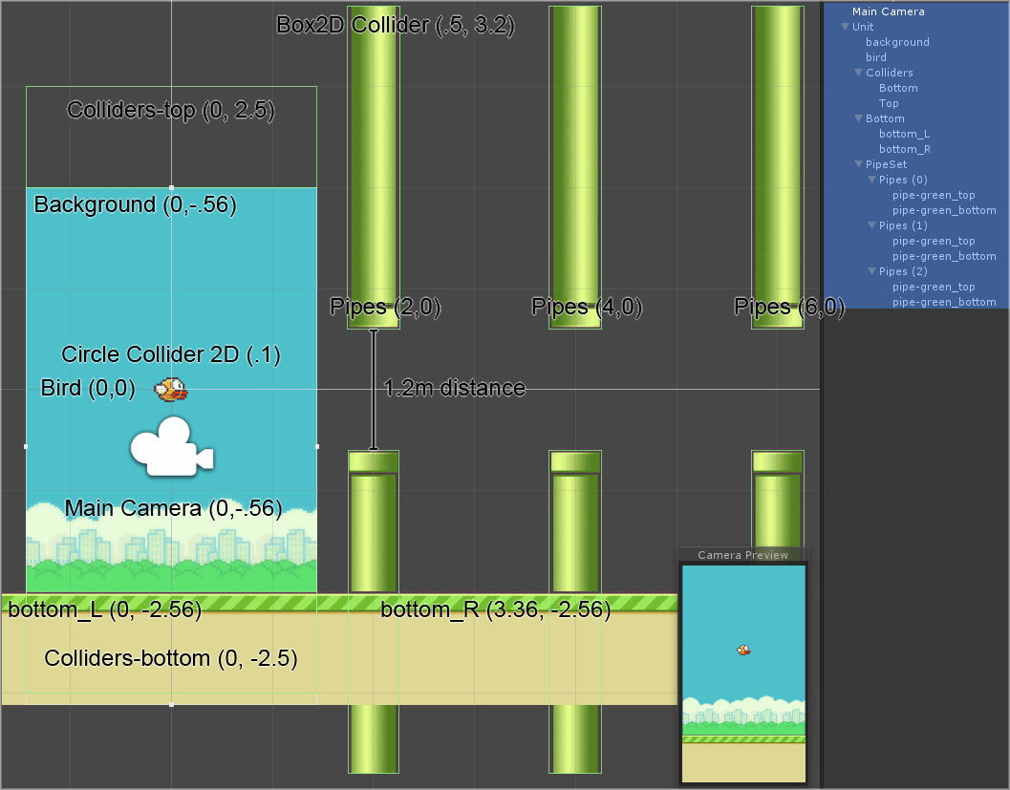
Game playing
Machine Learning for Flappy Bird using Neural Network & Genetic Algorithm
32%
70%
Notes:
<a href='http://www.freepik.com/free-photo/skyscraper-urban-view_881301.htm'>Designed by Freepik</a>

Slide 31
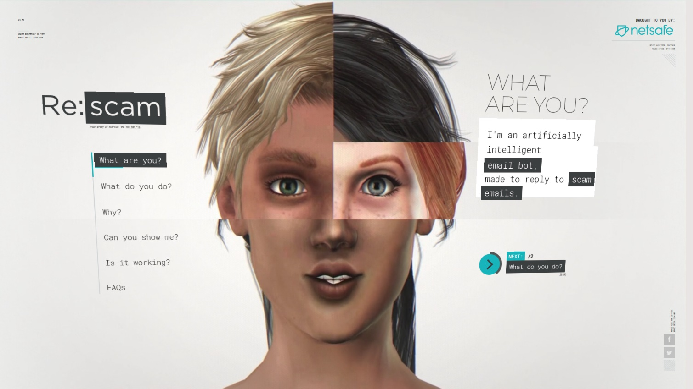
Spam fighting
Every year billions of dollars are being lost to scammers and spammers preying on trusting people While the crimes are borderless, so locating and prosecuting scammers is very difficult.
32%
It can adopt one of it’s many personalities to continue the conversations of any would-be victim.It waste their time with a never-ending series of questions and anecdotes so that they have less time to pursue real people.
70%
Re: scam the artificially intelligent email bot made to replay to scam emails
Notes:
<a href='http://www.freepik.com/free-photo/skyscraper-urban-view_881301.htm'>Designed by Freepik</a>

Slide 32
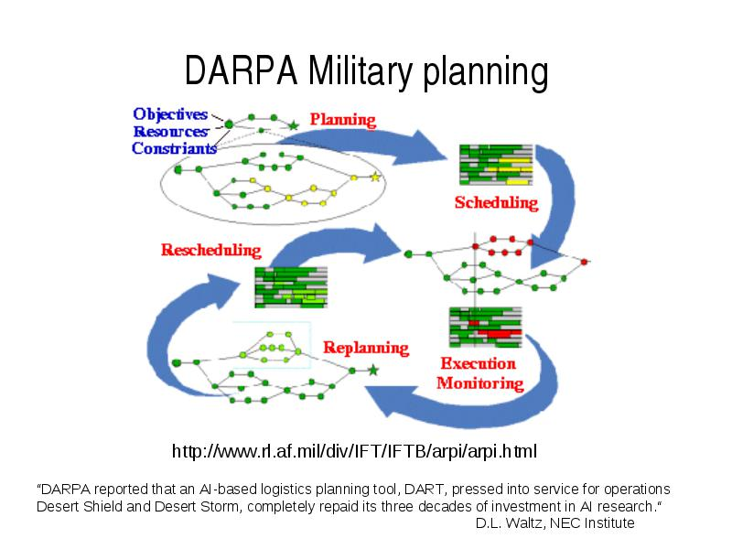
Logistics planning
32This can do automated logistics planning and scheduling for transportation. The AI planning techniques generated in hours a plan that would have taken weeks with older methods
%
70%
Dynamic Analysis and Replanning Tool (DART)
Notes:
<a href='http://www.freepik.com/free-photo/skyscraper-urban-view_881301.htm'>Designed by Freepik</a>

Slide 33
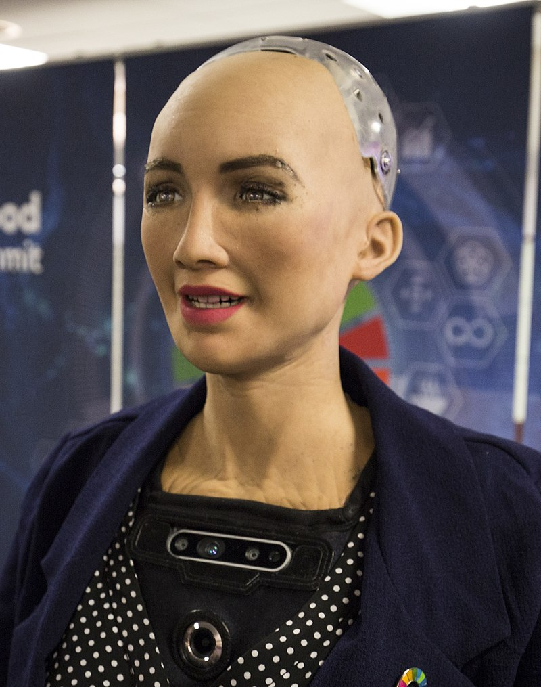
Robotic
Cameras within Sophia's eyes combined with computer algorithms allow her to see. It can follow faces, sustain eye contact, and recognize individuals. It is able to process speech and have conversations using a natural language subsystem. Around January 2018 Sophia was upgraded with functional legs and the ability to walk.
Sophia runs on artificially intelligent software that is constantly being trained in the lab, so her conversations are likely to get faster, Sophia's expressions are likely to have fewer errors, and it should answer increasingly complex questions with more accuracy.
70%
A social humanoid robot Sophia
Notes:
<a href='http://www.freepik.com/free-photo/skyscraper-urban-view_881301.htm'>Designed by Freepik</a>

Slide 34
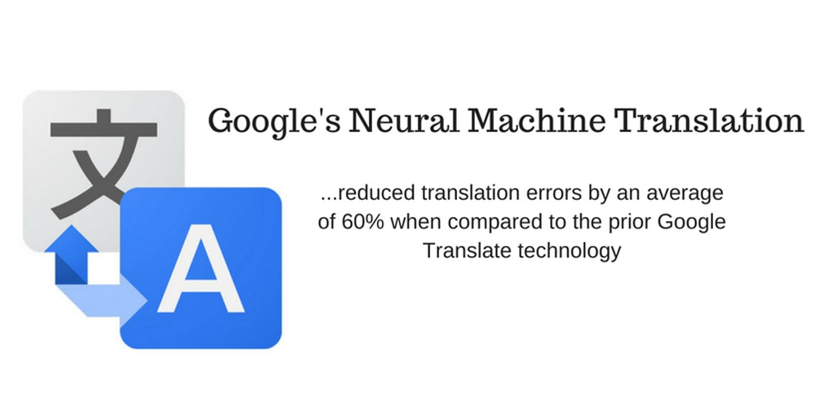
Machine translation
This system uses a large artificial neural network capable of deep learning. Google Neural Machine Translation uses millions of examples and improves the quality of its translation day by day
70%
An artificial neural network to increase fluency and accuracy in Google Translate
Notes:
<a href='http://www.freepik.com/free-photo/skyscraper-urban-view_881301.htm'>Designed by Freepik</a>

Slide 35

4. Summary

Slide 36
Different people approach AI with different goals in mind.
Intelligence is concerned mainly with rational action. Ideally, an intelligent agent takes the best possible action in a situation.
AI has advanced more rapidly in the past decade because of greater use of the scientific method in experimenting with and comparing approaches.
Recent progress in understanding the theoretical basis for intelligence has gone hand in hand with improvements in the capabilities of real systems. The subfields of AI have become more integrated, and AI has found common ground with other disciplines.
References: [1] Stuart J. Rusell and Peter Norvig – Artificial Intelligence A Modern Approach 3rd Edition 2016. [2]

Slide 37
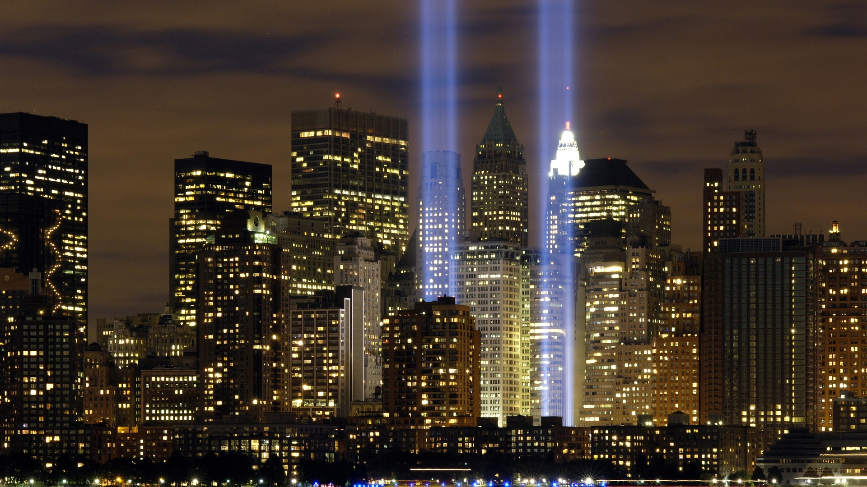
Thank you for your listening
Notes:
https://pixabay.com/en/new-york-city-tribute-in-lights-sky-78181/

